Slide 1
Lab 9 solution hint
by wwy

Slide 2
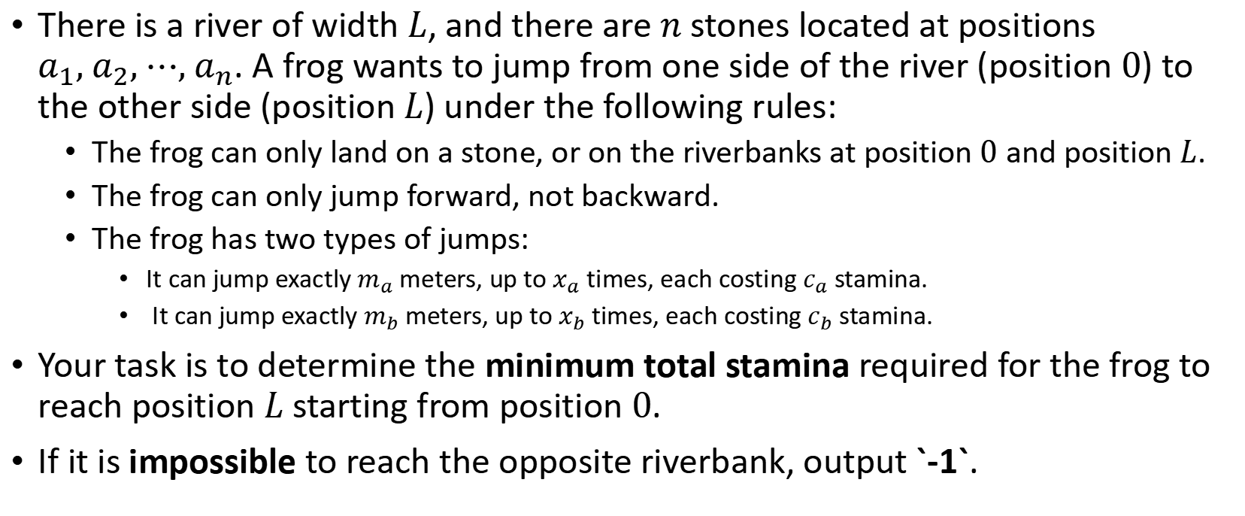
Lab9A
There is a river of width $L$, and there are $n$ stones located at positions $a_{1}, a_{2}, ⋯, a_{n}$. A frog wants to jump from one side of the river (position $0$) to the other side (position $L$) under the following rules:
The frog can only land on a stone, or on the riverbanks at position $0$ and position $L$.
The frog can only jump forward, not backward.
The frog has two types of jumps:
It can jump exactly $m_{a}$ meters, up to $x_{a}$ times, each costing $c_{a}$ stamina.
It can jump exactly $m_{b}$ meters, up to $x_{b}$ times, each costing $c_{b}$ stamina.
Your task is to determine the minimum total stamina required for the frog to reach position $L$ starting from position $0$.
If it is impossible to reach the opposite riverbank, output `-1`.

Slide 3
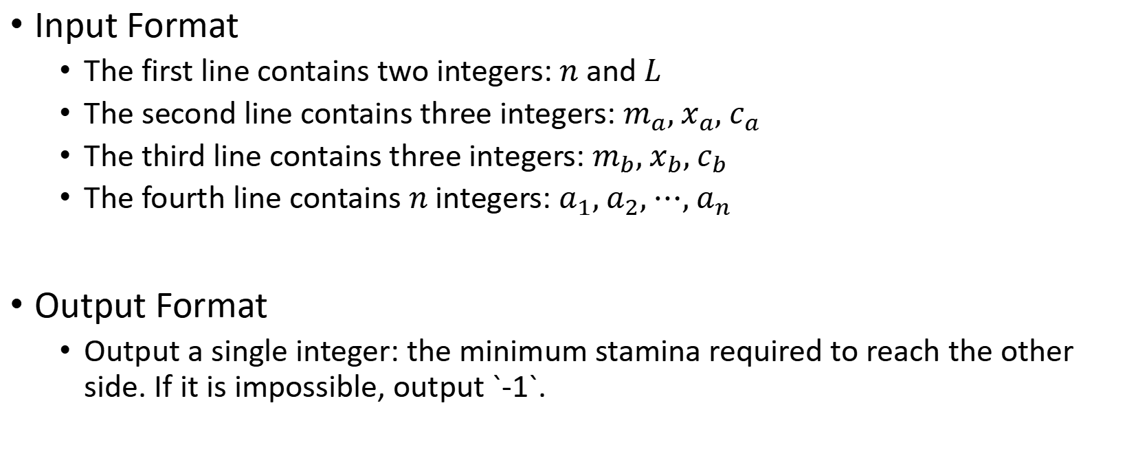
Lab9A
Input Format
The first line contains two integers: $n$ and $L$
The second line contains three integers: $m_{a}, x_{a}, c_{a}$
The third line contains three integers: $m_{b}, x_{b}, c_{b}$
The fourth line contains $n$ integers: $a_{1}, a_{2}, ⋯, a_{n}$
Output Format
Output a single integer: the minimum stamina required to reach the other side. If it is impossible, output `-1`.

Slide 4
Lab9A
10 20
2 9 9
3 6 5
3 4 5 7 9 11 13 15 17 19
73
5 9 9 9 9 9 9 9 5
0
3
4
5
7
9
11
13
15
17
19
20

Slide 5
Lab9A
15 50
5 20 9
7 15 5
3 4 5 7 12 17 18 19 21 26 31 37 38 41 45
52
5 9 5 5 9 5 5 9
0
3
4
5
7
12
17
18
19
21
26
31
37
38
41
45
50

Slide 6
Dynamic-programming steps
When developing a dynamic-programming algorithm, we follow a sequence of four steps: 1. Characterize the structure of an optimal solution. 2. Recursively define the value of an optimal solution. 3. Compute the value of an optimal solution, typically in a bottom-up fashion. 4. Construct an optimal solution from computed information. Steps 1–3 form the basis of a dynamic-programming solution to a problem. If we need only the value of an optimal solution, and not the solution itself, then we can omit step 4.

Slide 7


1. Characterize the structure of an optimal solution.
10 20
2 9 9
3 6 5
3 4 5 7 9 11 13 15 17 19
$$m_{a}, x_{a}, c_{a}$$
$$m_{b}, x_{b}, c_{b}$$
Initial problem:
Position: 20
Jump a number:<= 9
Jump b number:<= 6
0
3
4
5
7
9
11
13
15
17
19
20
Position: 18 invalid
2*1
Jump a
Position:17 valid Jump a number: 9
Jump b number: 5
3*1
Jump b

Slide 8
1.Characterize the structure of an optimal solution.
0
3
4
5
7
9
11
13
15
17
19
20
Position: 18 invalid
2*1
Jump a
Position:17 valid Jump a number: <=9 Jump b number: <=5
3*1
Jump b
2*1
Jump a
Position:15 valid Jump a number: <=8 Jump b number: <=5
Position: 14 invalid
3*1
Jump b
......
Position:1 invalid
2*1
Jump a
3*1
Position: 0 valid
Jump b

Slide 9
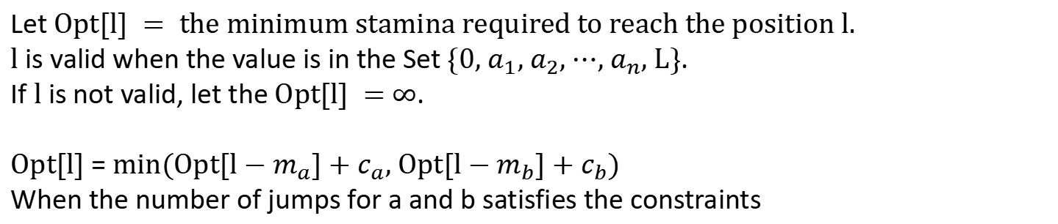
2. Recursively define the value of an optimal solution.
Let $Opt[l] = the minimum stamina required to reach the position l.$
$l$ is valid when the value is in the Set $\{0, a_{1}, a_{2}, ⋯, a_{n}, L\}$.
If $l$ is not valid, let the $Opt[l] =$ $∞$.
$Opt[l]$ = $min(Opt[l−m_{a}]+c_{a}, Opt[l−m_{b}]+c_{b})$
When the number of jumps for a and b satisfies the constraints
This implies that we need to record the number of type a and type b jumps already used.
$Opt[l][i][j]$ = $min(Opt[l−m_{a}][i−1][j]+c_{a}, Opt[l−m_{b}][i][j−1]+c_{b})$

Slide 10


2. Recursively define the value of an optimal solution.
$Opt[l][i][j]$ = $min(Opt[l−m_{a}][i−1][j]+c_{a}, Opt[l−m_{b}][i][j−1]+c_{b})$
$$l≤{10}^{6},i,j≤5×{10}^{3}$$

Slide 11
2. Recursively define the value of an optimal solution.
$$l=i×m_{a}+j×m_{b}$$
$Opt[l][i][j]$ = $min(Opt[l−m_{a}][i−1][j]+c_{a}, Opt[l−m_{b}][i][j−1]+c_{b})$
$Opt[i][j]$ = $min(Opt[i−1][j]+c_{a}, Opt[i][j−1]+c_{b})$

Slide 12
3.Compute the value of an optimal solution, typically in a bottom-up fashion.
Initial:
 | 0 | 1 | 2 | 3 | 4 | 5 | 6
0 | 0 | ∞ | ∞ | ∞ | ∞ | ∞ | ∞
1 | ∞ | ∞ | ∞ | ∞ | ∞ | ∞ | ∞
2 | ∞ | ∞ | ∞ | ∞ | ∞ | ∞ | ∞
3 | ∞ | ∞ | ∞ | ∞ | ∞ | ∞ | ∞
4 | ∞ | ∞ | ∞ | ∞ | ∞ | ∞ | ∞
5 | ∞ | ∞ | ∞ | ∞ | ∞ | ∞ | ∞
6 | ∞ | ∞ | ∞ | ∞ | ∞ | ∞ | ∞
7 | ∞ | ∞ | ∞ | ∞ | ∞ | ∞ | ∞
8 | ∞ | ∞ | ∞ | ∞ | ∞ | ∞ | ∞
9 | ∞ | ∞ | ∞ | ∞ | ∞ | ∞ | ∞

Slide 13
3.Compute the value of an optimal solution, typically in a bottom-up fashion.
Jump b
Initial:
 | 0 | 1 | 2 | 3 | 4 | 5 | 6
0 | 0 | 5 | ∞ | ∞ | ∞ | ∞ | ∞
1 | ∞ | 14 | ∞ | ∞ | ∞ | ∞ | ∞
2 | ∞ | 23 | ∞ | ∞ | ∞ | ∞ | ∞
3 | ∞ | 32 | ∞ | ∞ | ∞ | ∞ | ∞
4 | ∞ | 41 | ∞ | ∞ | ∞ | ∞ | ∞
5 | ∞ | 50 | ∞ | ∞ | ∞ | ∞ | ∞
6 | ∞ | 59 | ∞ | ∞ | ∞ | ∞ | ∞
7 | ∞ | 68 | 73 | ∞ | ∞ | ∞ | ∞
8 | ∞ | 77 | ∞ | ∞ | ∞ | ∞ | ∞
9 | ∞ | ∞ | ∞ | ∞ | ∞ | ∞ | ∞
Jump a
2*7+3*2 = 20=L

Slide 14
Other method
init array stone, location
for i<--index of stone[]
if stone[i].sta is equal to -1
continue
#check ma
next_loc = stone[i]+ma
if next_loc<=L && location[next_loc]!=0 &&stones[i].cxa<xa
if (stones[i].sta+ca>0 and stones[location[next_loc]].sta==-1)or
(stones[i].sta+ca>0 and stones[location[next_loc]].sta>0 and
stones[i].sta+ca< stones[location[next_loc]].sta)
stones[location[next_loc]].sta = stones[i].sta+ca;
stones[location[next_loc]].cxa = stones[i].cxa+1
stones[location[next_loc]].cxb = stones[i].cxb
}
#check mb
next_loc = stone[i]+mb
if next_loc<=L && location[next_loc]!=0 &&stones[i].cxb<xb
if (stones[i].sta+cb>0 and stones[location[next_loc]].sta==-1)or
(stones[i].sta+cb>0 and stones[location[next_loc]].sta>0 and
stones[i].sta+cb< stones[location[next_loc]].sta)
stones[location[next_loc]].sta = stones[i].sta+cb;
stones[location[next_loc]].cxa = stones[i].cxa
stones[location[next_loc]].cxb = stones[i].cxb+1
stone
loc
cxa
cxb
sta
0
3
4
5
7
12
17
18
19
21
26
31
37
38
41
45
0
-1
-1
...
location
1
2
3
4
5
6
7
8
9
10
11
12
13
14
0 1 2 3 4 5 6 7 8 9 10 11 12 13 14 15 16 17 18 19 20 21 22 23 24 25 26 27 28 29 30 31 32 33 34 35 36 37 38 39 40 41 42 43 44 45 46 47 48 49 50

Slide 15
Other method
i=0
next_loc=5
stone[3].sta=9,stone[3].cxa=1,stone[3].cxb=0
next_loc=7
stone[4].sta=5,stone[4].cxa=0,stone[4].cxb=1
stone
loc
cxa
cxb
sta
0
3
4
5
7
12
17
18
19
21
26
31
37
38
41
45
50
0
1
0
0
0
1
0
-1
-1
9
5
-1
-1
-1
-1
-1
-1
-1
-1
-1
-1
-1
-1
location
1
2
3
4
5
6
7
8
9
10
11
12
13
14
0 1 2 3 4 5 6 7 8 9 10 11 12 13 14 15 16 17 18 19 20 21 22 23 24 25 26 27 28 29 30 31 32 33 34 35 36 37 38 39 40 41 42 43 44 45 46 47 48 49 50

Slide 16
Other method
i=3
next_loc=10
next_loc=12
stone[5].sta=14,stone[5].cxa=1,stone[5].cxb=1
i=4
next_loc=12
stone[5].sta=14,stone[5].cxa=1,stone[5].cxb=1
next_loc=14
i=0
next_loc=5
stone[3].sta=9,stone[3].cxa=1,stone[3].cxb=0
next_loc=7
stone[4].sta=5,stone[4].cxa=0,stone[4].cxb=1
stone
loc
cxa
cxb
sta
0
3
4
5
7
12
17
18
19
21
26
31
37
38
41
45
50
0
1
0
1
0
0
1
1
0
-1
-1
9
5
14
-1
-1
-1
-1
-1
-1
-1
-1
-1
-1
-1
location
1
2
3
4
5
6
7
8
9
10
11
12
13
14
0 1 2 3 4 5 6 7 8 9 10 11 12 13 14 15 16 17 18 19 20 21 22 23 24 25 26 27 28 29 30 31 32 33 34 35 36 37 38 39 40 41 42 43 44 45 46 47 48 49 50

Slide 17
Other method
i=3
next_loc=10
next_loc=12
stone[5].sta=14,stone[5].cxa=1,stone[5].cxb=1
i=4
next_loc=12
stone[5].sta=14,stone[5].cxa=1,stone[5].cxb=1
next_loc=14
i=5
next_loc=17
stone[6].sta=23,stone[6].cxa=2,stone[6].cxb=1
next_loc=19
stone[7].sta=19,stone[7].cxa=1,stone[7].cxb=2
i=0
next_loc=5
stone[3].sta=9,stone[3].cxa=1,stone[3].cxb=0
next_loc=7
stone[4].sta=5,stone[4].cxa=0,stone[4].cxb=1
stone
loc
cxa
cxb
sta
0
3
4
5
7
12
17
18
19
21
26
31
37
38
41
45
50
0
1
0
1
2
1
0
0
1
1
1
2
0
-1
-1
9
5
14
23
-1
19
-1
-1
-1
-1
-1
-1
-1
-1
location
1
2
3
4
5
6
7
8
9
10
11
12
13
14
0 1 2 3 4 5 6 7 8 9 10 11 12 13 14 15 16 17 18 19 20 21 22 23 24 25 26 27 28 29 30 31 32 33 34 35 36 37 38 39 40 41 42 43 44 45 46 47 48 49 50

Slide 18
Other method
i=7
next_loc=24
next_loc=26
stone[9].sta=25,stone[9].cxa=1,stone[9].cxb=3
i=6
next_loc=22
next_loc=24
stone
loc
cxa
cxb
sta
0
3
4
5
7
12
17
18
19
21
26
31
37
38
41
45
50
0
1
0
1
2
1
1
0
0
1
1
1
2
3
0
-1
-1
9
5
14
23
-1
19
-1
25
-1
-1
-1
-1
-1
-1
location
1
2
3
4
5
6
7
8
9
10
11
12
13
14
0 1 2 3 4 5 6 7 8 9 10 11 12 13 14 15 16 17 18 19 20 21 22 23 24 25 26 27 28 29 30 31 32 33 34 35 36 37 38 39 40 41 42 43 44 45 46 47 48 49 50

Slide 19
Other method
i=7
next_loc=24
next_loc=26
stone[9].sta=25,stone[9].cxa=1,stone[9].cxb=3
i=6
next_loc=22
next_loc=24
stone
loc
cxa
cxb
sta
0
3
4
5
7
12
17
18
19
21
26
31
37
38
41
45
50
0
1
0
1
2
1
1
0
0
1
1
1
2
3
0
-1
-1
9
5
14
23
-1
19
-1
25
-1
-1
-1
-1
-1
-1
location
1
2
3
4
5
6
7
8
9
10
11
12
13
14
0 1 2 3 4 5 6 7 8 9 10 11 12 13 14 15 16 17 18 19 20 21 22 23 24 25 26 27 28 29 30 31 32 33 34 35 36 37 38 39 40 41 42 43 44 45 46 47 48 49 50

Slide 20
Other method
i=7
next_loc=24
next_loc=26
stone[9].sta=25,stone[9].cxa=1,stone[9].cxb=3
i=6
next_loc=22
next_loc=24
stone
loc
cxa
cxb
sta
0
3
4
5
7
12
17
18
19
21
26
31
37
38
41
45
50
0
1
0
1
2
1
1
0
0
1
1
1
2
3
0
-1
-1
9
5
14
23
-1
19
-1
25
-1
-1
-1
-1
-1
-1
location
1
2
3
4
5
6
7
8
9
10
11
12
13
14
0 1 2 3 4 5 6 7 8 9 10 11 12 13 14 15 16 17 18 19 20 21 22 23 24 25 26 27 28 29 30 31 32 33 34 35 36 37 38 39 40 41 42 43 44 45 46 47 48 49 50

Slide 21
Other method
i=7
next_loc=24
next_loc=26
stone[9].sta=25,stone[9].cxa=1,stone[9].cxb=3
i=8
i=9
next_loc=31
stone[10].sta=34,stone[10].cxa=2,stone[9].cxb=3
next_loc=33
i=6
next_loc=22
next_loc=24
stone
loc
cxa
cxb
sta
0
3
4
5
7
12
17
18
19
21
26
31
37
38
41
45
50
0
1
0
1
2
1
1
2
0
0
1
1
1
2
3
3
0
-1
-1
9
5
14
23
-1
19
-1
25
34
-1
-1
-1
-1
-1
location
1
2
3
4
5
6
7
8
9
10
11
12
13
14
0 1 2 3 4 5 6 7 8 9 10 11 12 13 14 15 16 17 18 19 20 21 22 23 24 25 26 27 28 29 30 31 32 33 34 35 36 37 38 39 40 41 42 43 44 45 46 47 48 49 50

Slide 22
Other method
i=7
next_loc=24
next_loc=26
stone[9].sta=25,stone[9].cxa=1,stone[9].cxb=3
i=8
i=9
next_loc=31
stone[10].sta=34,stone[10].cxa=2,stone[9].cxb=3
next_loc=33
i=10
next_loc=36
next_loc=38
stone[12].sta=34,stone[12].cxa=2,stone[12].cxb=4
i=6
next_loc=22
next_loc=24
stone
loc
cxa
cxb
sta
0
3
4
5
7
12
17
18
19
21
26
31
37
38
41
45
50
0
1
0
1
2
1
1
2
2
0
0
1
1
1
2
3
3
4
0
-1
-1
9
5
14
23
-1
19
-1
25
34
-1
39
-1
-1
-1
location
1
2
3
4
5
6
7
8
9
10
11
12
13
14
15
0 1 2 3 4 5 6 7 8 9 10 11 12 13 14 15 16 17 18 19 20 21 22 23 24 25 26 27 28 29 30 31 32 33 34 35 36 37 38 39 40 41 42 43 44 45 46 47 48 49 50

Slide 23
Other method
i=11
i=12
next_loc=43
next_loc=45
stone[14].sta=43,stone[14].cxa=2,stone[1].cxb=5
stone
loc
cxa
cxb
sta
0
3
4
5
7
12
17
18
19
21
26
31
37
38
41
45
50
0
1
0
1
2
1
1
2
2
2
0
0
1
1
1
2
3
3
4
5
0
-1
-1
9
5
14
23
-1
19
-1
25
34
-1
39
-1
43
-1
location
1
2
3
4
5
6
7
8
9
10
11
12
13
14
15
0 1 2 3 4 5 6 7 8 9 10 11 12 13 14 15 16 17 18 19 20 21 22 23 24 25 26 27 28 29 30 31 32 33 34 35 36 37 38 39 40 41 42 43 44 45 46 47 48 49 50

Slide 24
Other method
i=13
i=14
next_loc=50
stone[15].sta=52,stone[15].cxa=3,stone[15].cxb=5
next_loc=52
i=11
i=12
next_loc=43
next_loc=45
stone[14].sta=43,stone[14].cxa=2,stone[14].cxb=5
stone
loc
cxa
cxb
sta
0
3
4
5
7
12
17
18
19
21
26
31
37
38
41
45
50
end
0
1
0
1
2
1
1
2
2
2
3
0
0
1
1
1
2
3
3
4
5
5
0
-1
-1
9
5
14
23
-1
19
-1
25
34
-1
39
-1
43
-1
location
1
2
3
4
5
6
7
8
9
10
11
12
13
14
15
0 1 2 3 4 5 6 7 8 9 10 11 12 13 14 15 16 17 18 19 20 21 22 23 24 25 26 27 28 29 30 31 32 33 34 35 36 37 38 39 40 41 42 43 44 45 46 47 48 49 50

Slide 25
Lab9B
At the end of the semester, a student at SUSTech wants to thank a TA who has provided significant help throughout the term. To show appreciation, the student decides to buy the TA’s favorite treat — milk candy. However, after recently buying gifts for friends during his holiday, the student only has n yuan left. Fortunately, the nearby campus store offers m types of milk candy, each sold as a whole package and not individually.
The student wants to buy some candy without exceeding the budget and aims to maximize the total sugar content obtained. Please help calculate the maximum sugar he can get, along with the specific number of packages to buy for each candy type.
Given an integer n (the total amount of money available) and m (the number of candy types), along with the price and sugar content of each type of candy, determine:
The maximum total sugar the student can obtain within the budget;
A valid purchase plan, showing how many units of each candy to buy.
Each candy type has an unlimited supply, and each unit has a positive integer price.
It is guaranteed that there exists exactly one optimal solution.

Slide 26
Lab9B
Input Format
The first line contains two integers, n and m — the amount of money available and the number of candy types.
The next m lines each contain two integers a and b, where a is the price and b is the sugar content of that type.
Output Format
The first line outputs a single integer: the maximum total sugar that can be obtained.
The following m lines: the j-th line (1-based) should output the number of units bought of the j-th type of candy.

Slide 27
Lab9B
70 3
71 100
69 1
1 2
140
0
0
70

Slide 28
Knapsack problem
0-1 Knapsack problem：Given weights and values of n items, put these items in a knapsack of capacity W to get the maximum total value in the knapsack. You cannot break an item, either pick the complete item or don’t pick it (0-1 property). This is the most basic Knapsack problem, which is explained in detail in the theory class 。
Unbounded Knapsack Problem(完全背包): for each item, you can put as many times as you want.

Slide 29
0-1 Knapsack problem
0-1 Knapsack problem equation：

Slide 30
Review:

Slide 31
Pseudo-code

Slide 32
Space complexity optimization of 0-1 knapsack
To calculate the new values of row i, only rows i -1 needed. The data from rows 0 to i -2 do not need storage space.

Slide 33

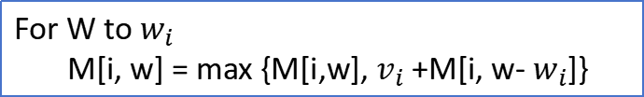
For W to $w_{i}$
M[w] = max {M[w], $v_{i}$+M[w- $w_{i}$]}
For W to $w_{i}$
M[i, w] = max {M[i,w], $v_{i}$+M[i, w- $w_{i}$]}

Slide 34
If the 'less than or equal to' constraint in the 0-1 knapsack problem is changed to an equality constraint, how should the problem be solved?
=

Slide 35
=
M[0] = 0;
for w = 1 to W
M[w] = -∞

Slide 36
Unbounded Knapsack Problem(完全背包)

Slide 37
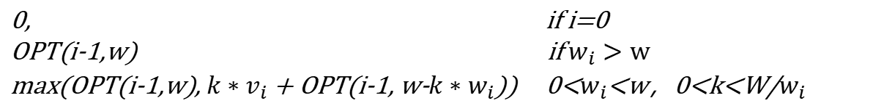
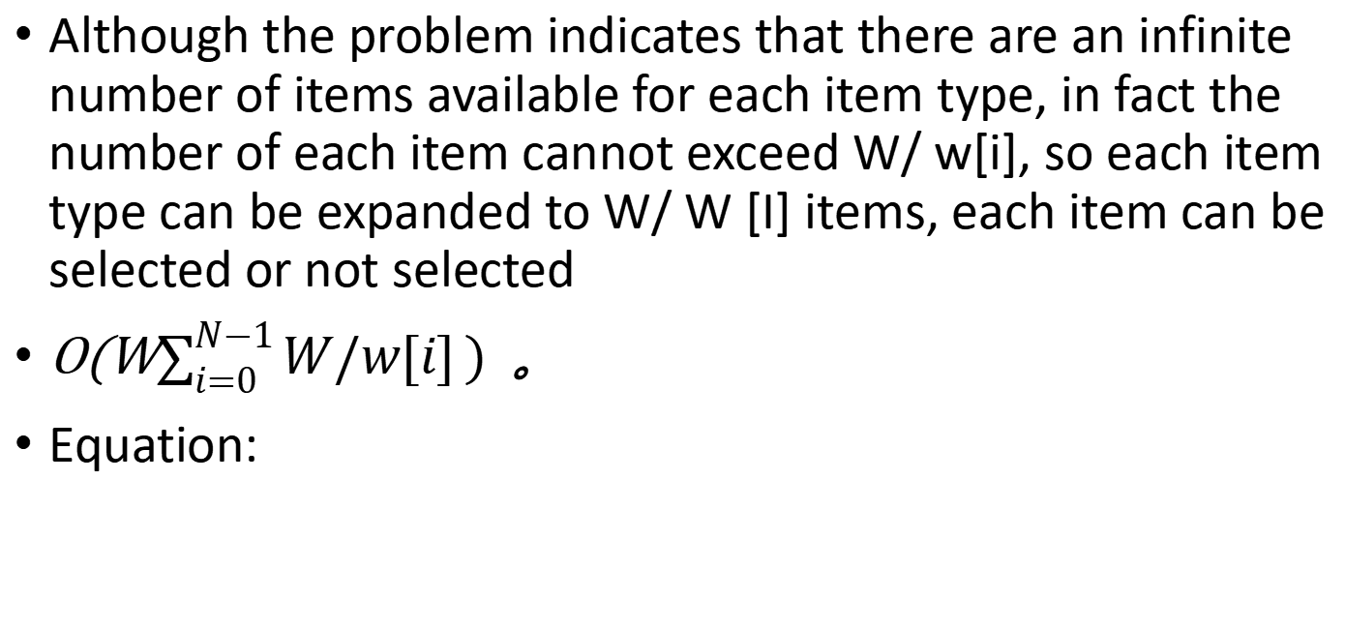
Unbounded Knapsack
0-1 Knapsack
Although the problem indicates that there are an infinite number of items available for each item type, in fact the number of each item cannot exceed W/ w[i], so each item type can be expanded to W/ W [I] items, each item can be selected or not selected
O(W$\sum_{i=0}^{N−1}{W/w[i]})$ 。
Equation:
0, if i=0
OPT(i-1,w) if $w_{i}>w$
max(OPT(i-1,w), ${k∗v}_{i}$+ OPT(i-1, w-${k∗w}_{i}$)) 0<$w_{i}$<w，0<k<W/$w_{i}$
OPT(i,w) =

Slide 38
Example:
weight = 15
Item No. | Item type | value | weight
1 | 0 | 13 | 5
2 | 0 | 13 | 5
3 | 0 | 13 | 5
4 | 1 | 17 | 7
5 | 1 | 17 | 7
6 | 2 | 22 | 8
 | 0 | 1 | 2 | … | 15
ø
{1}
{1,2}
{1,2,3}
{1,2,3,4}
{1,2,3,4,5}
{1,2,3,4,5,6}
Item type | value | weight
0 | 13 | 5
1 | 17 | 7
2 | 22 | 8

Slide 39
efficient？
weight = 1500
Item No. | Item type | value | weight
1 | 0 | 13 | 5
.. | 0 | 13 | 5
300 | 0 | 13 | 5
301 | 1 | 17 | 7
.. | 1 | 17 | 7
514 | 1 | 17 | 7
515 | 2 | 22 | 8
… | 2 | 22 | 8
701 | 2 | 22 | 8
702*1501
Item type | value | weight
0 | 13 | 5
1 | 17 | 7
2 | 22 | 8

Slide 40
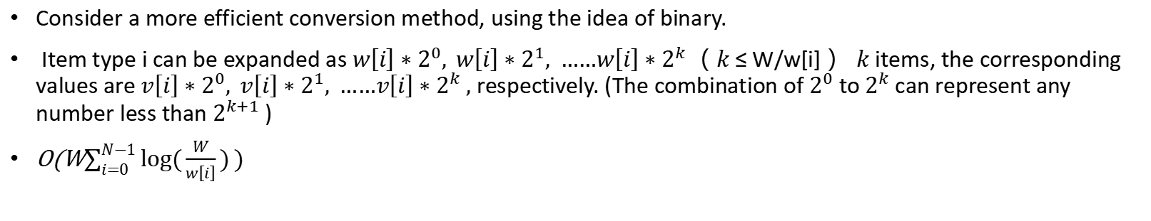
Consider a more efficient conversion method, using the idea of binary.
Item type i can be expanded as $w\left[i\right]∗2^{0}, w\left[i\right]∗2^{1}, ……w\left[i\right]∗2^{k}$（ $k$≤ W/w[i] ） $k$items, the corresponding values are $v\left[i\right]∗2^{0}, v\left[i\right]∗2^{1}, ……v\left[i\right]∗2^{k} ,$ respectively. (The combination of $2^{0}$ to $2^{k}$can represent any number less than $2^{k+1}$)
O(W$\sum_{i=0}^{N−1}{log⁡(\frac{W}{w\left[i\right]})})$
weight = 1500
Item No. | Item type | value | weight
1 | 0 | 13*2^0 | 5*2^0
… | … | … | …
9 | 0 | 13*2^8 | 5*2^8
10 | 1 | 17*2^0 | 7*2^0
… | … | … | …
17 | 1 | 17*2^7 | 7*2^7
18 | 2 | 22*2^0 | 8*2^0
… | … | … | …
25 | 2 | 22*2^7 | 8*2^7
26*1501
Item type | value | weight
0 | 13 | 5
1 | 17 | 7
2 | 22 | 8

Slide 41

O(W$\sum_{i=0}^{N−1}{log⁡(\frac{W}{w\left[i\right]})})$
Can be optimized to
O(NW)?

Slide 42
Unbounded Knapsack problem equation：
weight = 15
OPT(i,w) =max(OPT(i-1,w), $v_{i}$+ OPT(i, w-$w_{i}$))
Item type | value | weight
0 | 13 | 5
1 | 17 | 7
2 | 22 | 8
 | 0 | 1 | 2 | 3 | 4 | 5 | 6 | 7 | 8 | 9 | 10 | 11 | 12 | 13 | 14 | 15
ø | 0 | 0 | 0 | 0 | 0 | 0 | 0 | 0 | 0 | 0 | 0 | 0 | 0 | 0 | 0 | 0
{0} | 0 | 0 | 0 | 0 | 0 | 13 | 13 | 13 | 13 | 13 | 26 | 26 | 26 | 26 | 26 | 39
{0,1} | 0 | 0 | 0 | 0 | 0 | 13 | 13 | 17 | 17 | 17 | 26 | 26 | 30 | 30 | 34 | 39
{0,1,2} | 0 | 0 | 0 | 0 | 0 | 13 | 13 | 17 | 22 | 22 | 26 | 26 | 30 | 35 | 35 | 39
VS
0-1 Knapsack problem equation：
OPT(i,w) =max(OPT(i-1,w), $v_{i}$+ OPT(i-1, w-$w_{i}$))
 | 0 | 1 | 2 | 3 | 4 | 5 | 6 | 7 | 8 | 9 | 10 | 11 | 12 | 13 | 14 | 15
ø | 0 | 0 | 0 | 0 | 0 | 0 | 0 | 0 | 0 | 0 | 0 | 0 | 0 | 0 | 0 | 0
{0} | 0 | 0 | 0 | 0 | 0 | 13 | 13 | 13 | 13 | 13 | 13 | 13 | 13 | 13 | 13 | 13
{0,1} | 0 | 0 | 0 | 0 | 0 | 13 | 13 | 17 | 17 | 17 | 17 | 17 | 30 | 30 | 30 | 30
{0,1,2} | 0 | 0 | 0 | 0 | 0 | 13 | 13 | 17 | 22 | 22 | 22 | 22 | 30 | 35 | 35 | 39

Slide 43
0-1 Knapsack vs Unbounded Knapsack
0-1 Knapsack: To ensure that each item is selected only once, make sure that the “select the ith item” strategy is considered in terms of a sub result that has no ith item: f[i-1][w-w[i]]
Unbounded Knapsack: The characteristic of a Unbounded knapsack is that each item has an infinite number of items to choose from, so when considering the strategy of ”select the i-th item“, you need a sub result that might already be selected into the i-th item: f[i][w-w[i]]

Slide 44
Lab9B
Is a Unbounded Knapsack Problem

Slide 45
THX:-)

